Slide 1

Iowa
American Legion Auxiliary
Girls State
What you need to know!

Slide 2


HISTORY-
Iowa Girls State is a premier program of the American Legion Auxiliary which became a reality in 1946 when the first session was held on July 7-14 at Grandview College in Des Moines. This group of 5 devoted woman worked many hours during 1945-1946 to develop and implement the Girls State program.
They were Mrs. Leona Ladehoff, Clinton: Mrs. Margaret Hinderman, Wapello: Mrs. Margaret Carr, Des Moines: Mrs. Kay Hanson, Decorah: Mrs. Beona Young, Bloomfield. They provided the leadership and took part in the first session. Hawkeye Girls State as it was first known was set up with one county named Carr named after Margaret Carr, American Legion Auxiliary Department President in 1945, and one city Macrae, the first President of the Iowa American Legion Auxiliary and the first woman to serve as a National President from Iowa. There were 100 girls and 13 staff attending the first session.
During 1947 through 1952, the program was being held at Grinnell College, Grinnell where they could accommodate more girls. In 1948 the two- party system was established at a party convention, respectively. The Nationalist party (mascot Horse)and Federalist (mascot English bulldog).

Slide 3

Since the beginning of the formation of Iowa Girls State program it has continue to achieve its purpose by leading, challenging and encouraging young women of Iowa to forge forward. Believe in their self.
The sessions have increased in number of attendees, changed directors, engaged staff and moved locations all the while keeping the objective and motto of the Girls State program in mind;
              TODAY WE LEARN
                TOMORROW WE LEAD

Slide 4
FIRST question each unit or post asks in the fall-
Are we sponsoring a young lady to Iowa Girls State?

Slide 5
Need to decide!!!
WHAT ARE YOU WAITING FOR?
The Time is running out-
Make a decision
Deadline for Unit or Post reserving a spot, two or three is DECEMBER 31, 2024.
Don’t delay the decision-
Why not send a girl for a great opportunity?

Slide 6
REGISTRATION for the sponsoring group
Log into CampWise and register your American Legion Auxiliary or American Legion Post.
Sign in giving the account an ID and password. Such as your unit #, Town or Post #, town. Password: make it so you will remember.
After completing the registering your group, fill in the registration blank to reserve your number of attendees you will be sponsoring.
Please use the same registration information from year to year.
Your unit will be sent a CODE for the selectee to use to get into the CAMPWISE program for her registration purposes
If your unit does NOT receive the CODE by January 1, contact the Department Office.

Slide 7
DEADLINE DATES
December 31, 2024 Registering your UNIT or POST
  Reserve your spot or spots on CampWise. Reminder each spot is a $400.00 fee. This money will be due to CampWise after your selectee has completed the entire application and your unit or post receives an invoice. Remember, if sending more than one you may receive more than one invoice. DO NOT pay anything NOW!
  Your unit or post will receive a “special” Code to be given to your selectee- same CODE for multiple spots. This is units’ or posts’ “special” code, related to your account.
  March 31, 2025 - Final date for selectee to fill out application.
  To check on your attendee(s) application process, you can log in and check. Citizens may start the process as soon as she is given the code after the January 1. COMMUNICATE with the selectee.
  April 15, 2025- Unit Payment deadline
  If you have more than one citizen attending, you can wait to pay all of them at one time. But don’t delay. Please pay the invoice to CAMPWISE, not the DEPARTMENT office.

Slide 8
Selecting your Candidate for Iowa Girls State
All Girls State applicants must be selected by an American Legion Auxiliary Unit or Post. Local schools may provide names to unit, but it is the responsibility of the individual Units to make their own selections. In the event that a city/town does not have an active Unit, then the American Legion Post of that community may sponsor a citizen.
Outside organizations cannot sponsor a citizen, however, they may make a donation to a Unit to help sponsor a citizen. That Unit accepting the donation will be the legal sponsoring organization.

Slide 9
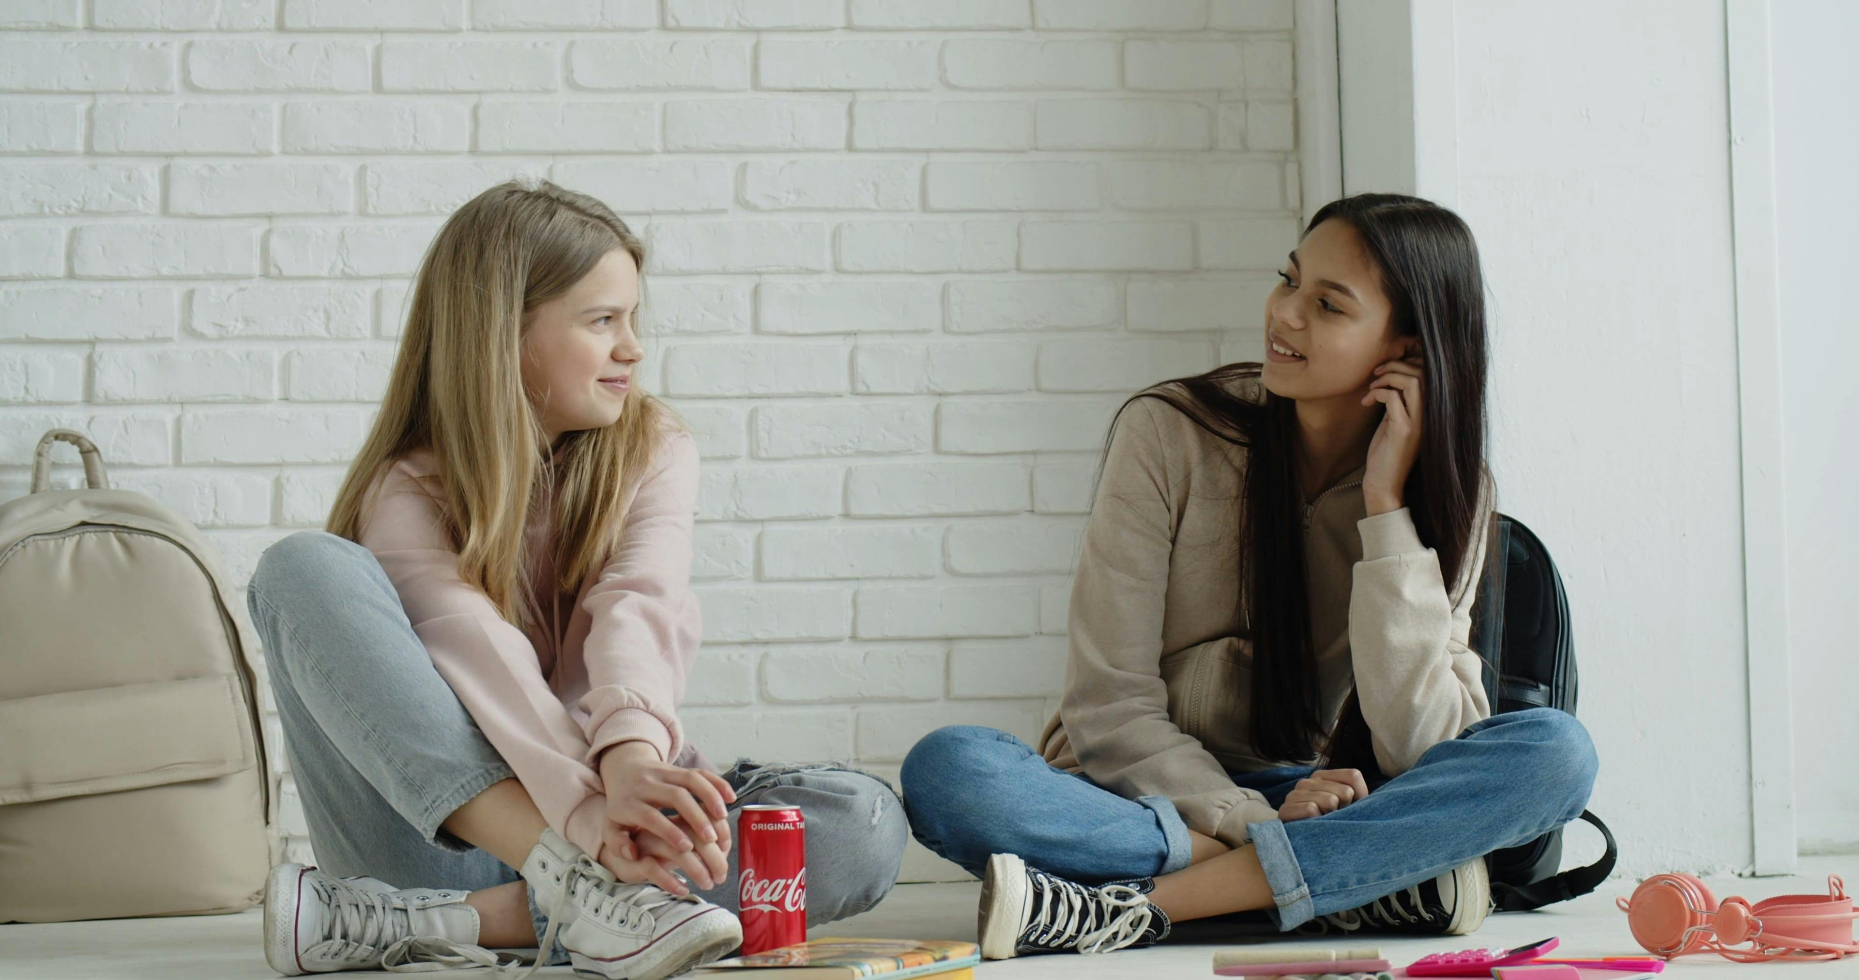
How to select your candidate
Decide how your group is going to select the young lady.
Some groups use an essay for decision making. They ask each tentative candidate to submit an essay describing why they want to attend?
You can go to the school and ask their opinion.
Use the in person concept for the interview process.
A designated committee from the unit decides who shall attend, then the members vote on the selection.
This is completely your units’ decision on how to decide to select your representative.

Slide 10
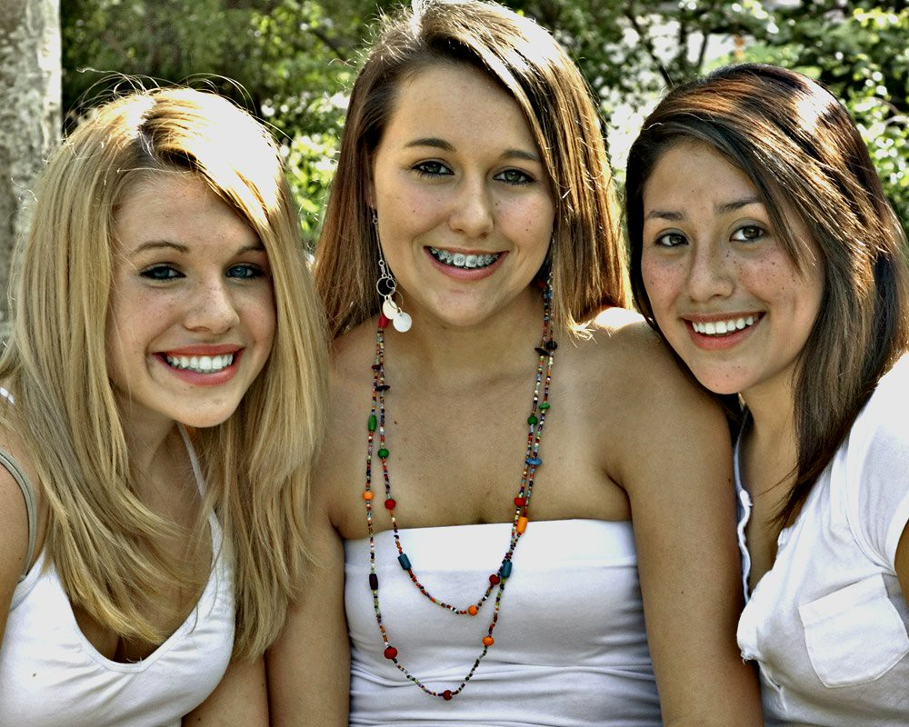
Who is the ideal candidate to attend?
      Candidates eligible to participate must have completed their junior year of high school and have at least one semester remaining, be a United States citizen or legal inhabitant of the United States as evidenced by a Green Card, or other United States government-issued documentation verifying a legal presence in the United States for at least the duration of the Girls State/ Girls Nation program.
      A student who demonstrates leadership potential and maturity to benefit from a weeklong immersive learning experience in a shared living arrangement with strangers.
      A candidate who has demonstrated scholastic achievement.
                Taken from Bluebook
Not listed in BLUEBOOK but highly recommended:
      A candidate who is both physically and mentally able to withstand 5 days of strenuous activity away from their normal activities.

Slide 11
After the selection of your candidate
What do you do?
Give your candidate the CODE that she needs to register on CAMPWISE.
Convince her to start the application process soon- no, she does not have to complete the entire form all at once. Wherever she leaves off, it will automatically return to that spot.
COMMUNICATE with her often- Don’t just select her and forget her. Contact her just before deadline for application time (March 31st) Then when the time for the session is to begin. Make her feel like she is the best thing since daylight.

Slide 12
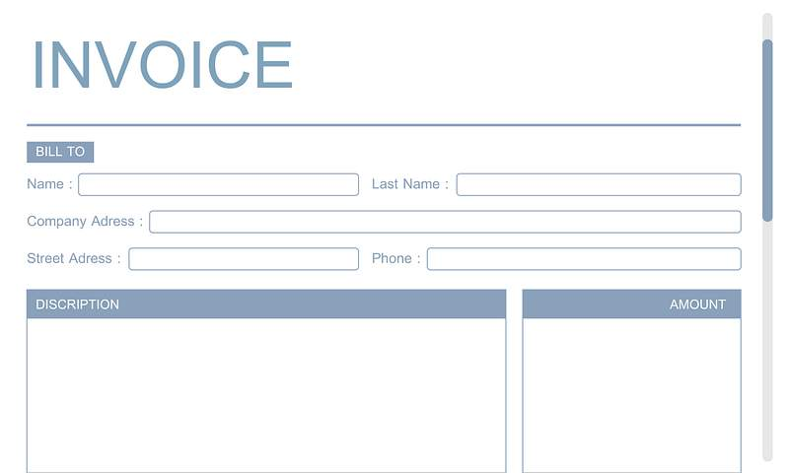


After, your selectee has completely registered.
What is the sponsoring group’s next obligation?
Now the unit/ posts next step is. Pay the invoice.
You will receive an invoice stating the amount due.
($ 400.00 per candidate)
Get on the CAMPWISE site, sign in, then click pay invoice. Your unit/post sends the money to CAMPWISE. They will submit to the department office.

Slide 13
COMMUNICATE
COMMUNICATE
COMMUNICATE
Make your selectee feel like she is the most important person ever.
  Contact her to be sure she has completed her complete application by March 31.
  Be in touch with her to ask if she has any questions
  The first of June or before contact her and say how excited you are to have her represent your organization at this years’ session.
  Most important- Stay in contact, don’t just select her, then forget her.
  Remind her that she will follow-up with your unit by giving a report to the unit/post.

Slide 14


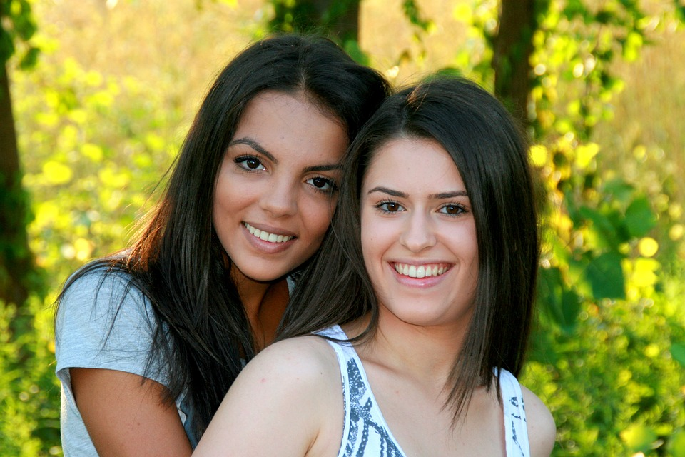
What does your sponsorship provide?
The Attendees Participation
Each attendee receives an official Girls State T shirt
The Girls State manual
The official Iowa Girls State Pin
A picture of the city in which she will be assigned to and a State picture
You are giving a young woman a chance to grow in self esteem, and self worth
You are helping in the growth of the Girls State program.
Memories and friendships that could last a Life-time.
-NC

Slide 15
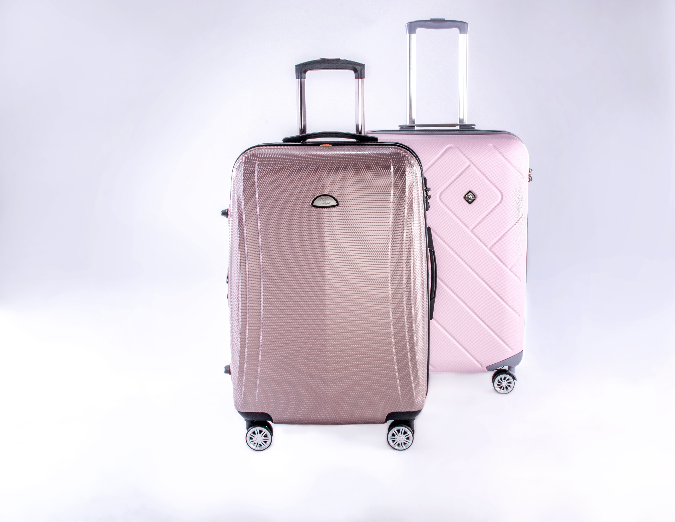
Packing List
Personal care items- shampoo, rinse, hairbrush, comb, soap, deodorant, lotion, whatever you use for personal hygiene
Professional Business Clothing- such as dresses, slacks and blouses, dress suits. NO blue jeans, athletic shorts, tank tops, halter tops, etc.
Dress Down Clothing- Bermuda shorts, etc. No short shorts
Nightwear shower shoes Formal attire
Bedding- Twin XL sheets (top and bottom), Blanket, pillow and pillowcase
Towels and washcloths Mirror Umbrella
Fan Sunglasses clothes hangers
Jacket Comfortable Shoes (flats are a good choice)
Personal Medicine Hook for towel drying
Cell Phone (personal use during free time)
Cash/ Card for Girls State Store Water Bottle
Bandaids Tote Bag or Backpack
Pencil/Pen Notebook Laptop
Leisure wear may be worn during your free time
DO NOT BRING- pre-printed campaign Material
Always use discretion when packing- they bring it – they carry it.

Slide 16

2025 Session
Iowa American Legion Auxiliary Girls State
Date: June 15-20, 2025
Where: Drake University.
      Des Moines Iowa
Registration: Citizens check in from 10 am till Noon Olmsted Center
No lunch is served at Drake University for attendees
The first meal served is the evening meal
Final Flag Lowering and Inauguration: June 20- 5:15 Flag with inauguration commencing at 5:30 (tentative times)

Slide 17

Arriving Checking in at Girls State
she is greeted by the official hostess the American Legion Auxiliary Department President and the reigning Girls State Governor.
She will give her name to some of the Government Staff for clarification
They will Present her name wallet, either red or blue.
Meets the nurse,
Visits the Girls State Store. The Store takes Cash or Credit.
Then, off to the Dorm, Goodwin Kirk.

Slide 18
TIME To Meet the District Counselors
After entering the dorm, she will meet her city counselors. They will help her locate her city, district and room.
She will receive her room key-
Roommate may or may not be there- But she will soon.
After selecting her bed- the unpacking will begin.
Take time to investigate the area -

Slide 19

IOWA AMERICAN LEGION AUXILIARY
GIRLS STATE Experience Begins
Clothing attire for citizens are Professional Business Attire
  The Iowa Girls State Board believe young ladies act the way they are dressed.
SUNDAY 1:00 PM Flag Etiquette
      1:15 PM Opening Ceremony
      Pictures are taken
Government begins starting with the District meeting
Each citizen will be in precinct 1 or 2, either a Nationalist or a Federalist (depending on the color of her neck wallet)
Federalist
Nationalist

Slide 20
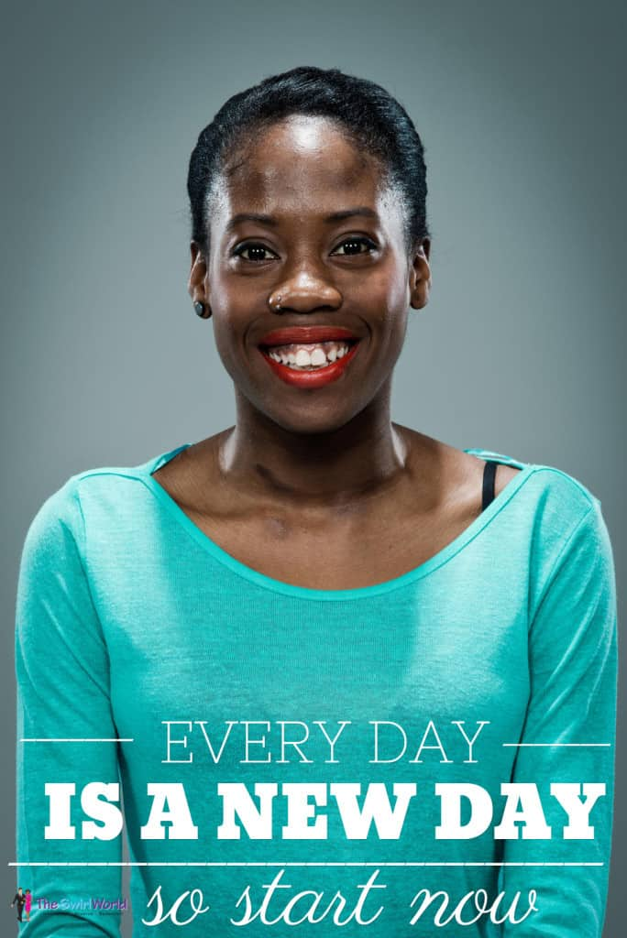
Daily Schedule: everyday is the same but different in one way or another
Get Up Breakfast Flag raising (weather permitting)
Morning Meditation (Dept President, Governor and district residents) Mass Meetings
Lunch Mass Meetings Some days we have a quest speaker Chorus
Supper Flag Lowering Guest Speaker Mass Meeting
Reflections District Meeting Good Night Lights Out Room Checks
Every morning there is running offered to the citizens (5:55 am) but no one goes alone- at least one staff goes with them.
As you can see- there is very little down time spent. Busy citizens create more memories and cause less trouble.

Slide 21
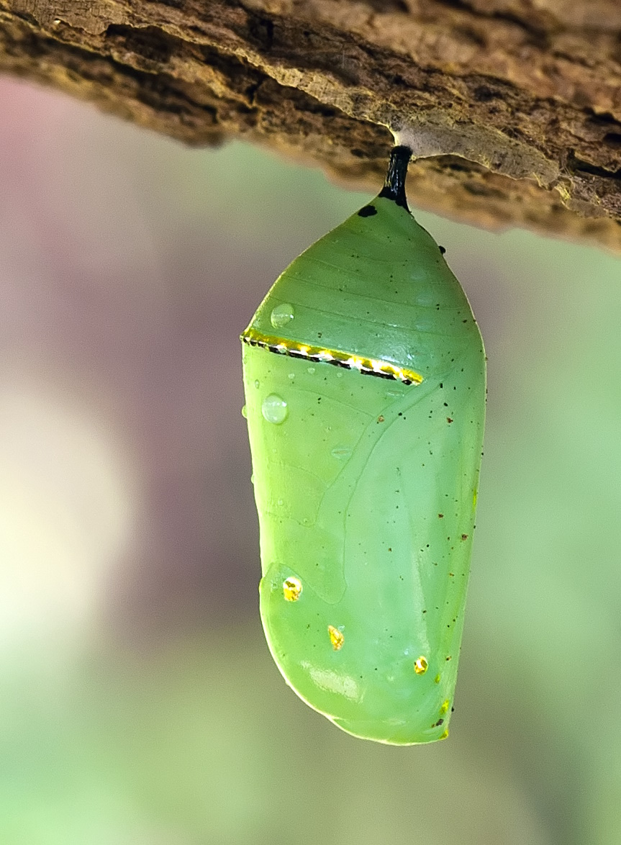
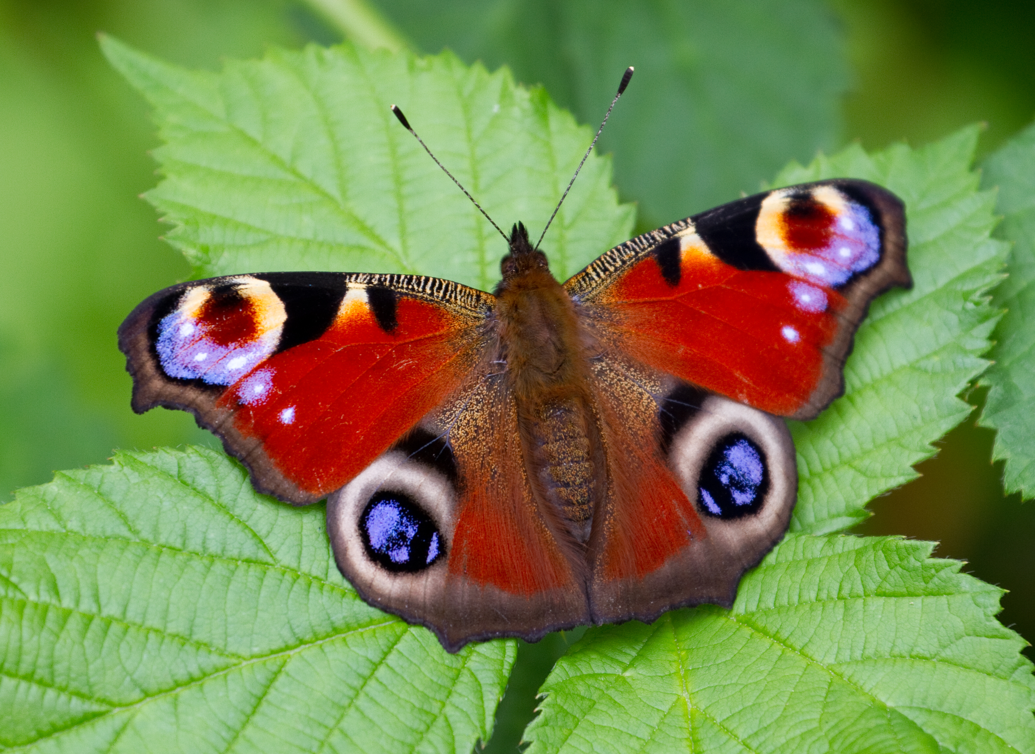
Do you wonder what changes for the citizen?
    They have grown into young women who found out about themselves.
    They found they could speak to a group of 300 plus
    Their self esteem has abounded
    They possibly found a new best friend that will last a life-time
    They discovered you can lose and still carry on.
    They found they could live with their peers and survive.
    They could live without their significant other, sports, etc.
    and the world keeps moving.
  The citizen arrives Sunday, then by Friday evening
  many have changed, they have grown and excelled.

Slide 22
American Legion Auxiliary Girls State Store
T Shirts
Nat and Fed T shirts
Sweatshirts hoodie
Pillows
Zippered sweatshirts
Pajama Pants
Personal items
Notebook
New items added
We take
CASH
Debit or Credit cards
Paper checks
BUY in person or ONLINE
Days open. Sunday through Friday Evening Hours: TBD

Slide 23

SCHOLARSHIPS
There are several scholarships offered at Girls State. Each year is different so we can not say exactly how many will be available each session.
The Samsung Corporation does offer one scholarship for a girl state citizen and a boy state citizen to be submitted for consideration from each department. Eligibility: a descendant of a veteran- plus points to be a Korean War veteran descendant. Community service points, essay points, GPA points plus more stuff are all considered in the selection process on the state level. Ask your representative to do the footwork or application as they say- Try for it- What does any student have to lose? No, it is not an easy application, but well worth time spent if sent on from each state. Check it out under the American Legion website.

Slide 24
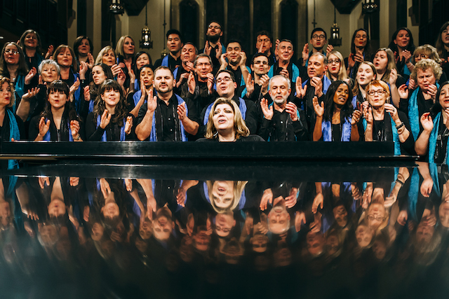

Chorus …. Parliamentary Procedure
Every citizen joins the Chorus at Girls State
  They all don’t like to sing but the Choir on Friday at
  Inauguration is fabulous.
  Roberts Rule of Order is a major at Girls State each year. The use of parliamentary procedure is used intensively during city meetings, county and state party conventions, plus in the House of Representatives and the Senate. Remind your attendee to brush up on parley pro. They will feel more comfortable if they do.

Slide 25
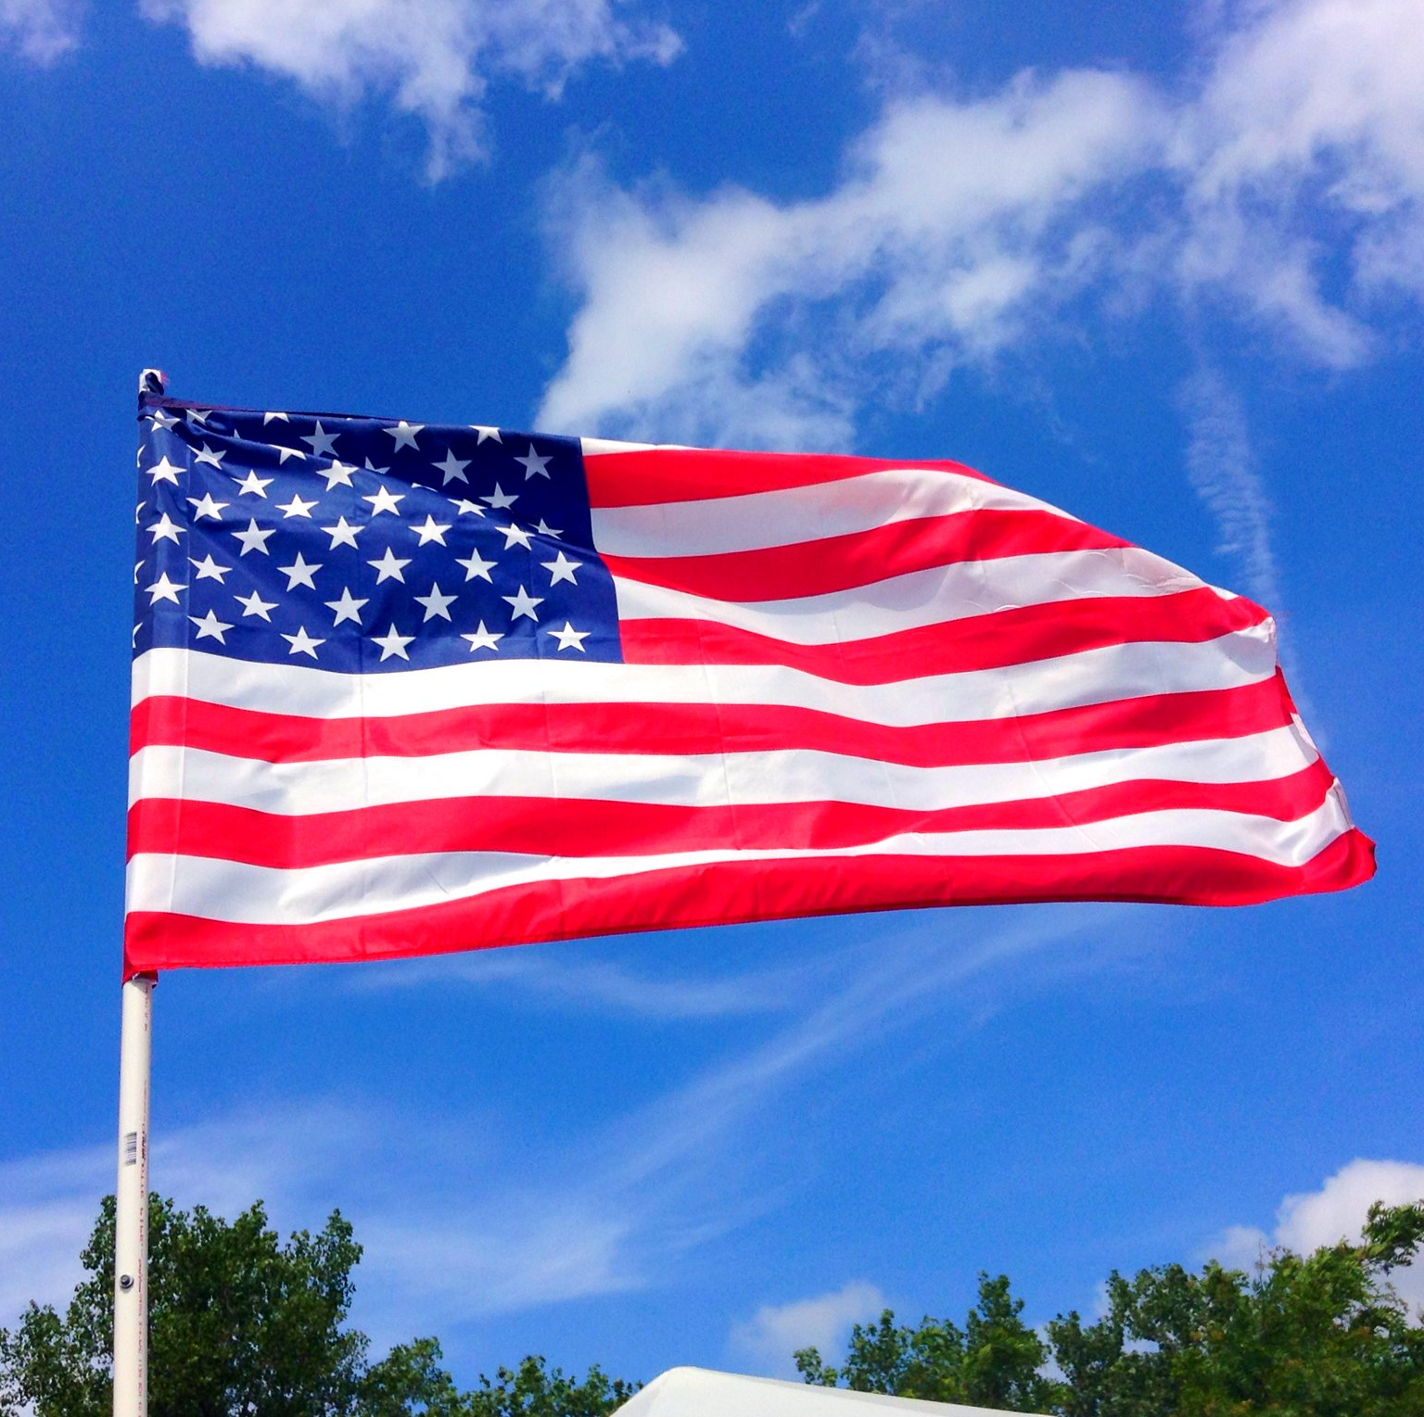
FLAG RAISING AND LOWERING
Every citizen in every district is given the opportunity to participate in the flag ceremony. Each District’s citizens will be given the chance to be in the color guard for the lowering or raising. The Counselors asks for volunteers- each citizen can volunteer.
Encourage them to take the challenge.

Slide 26

Participation…. Volunteers… Chances…
Participation is encouraged several times during the week.
Citizens may volunteer for a variety of tasks
    Morning meditation
    Flag ceremonies
    Evening reflections
    Encourage them to get out of their comfort zone. Take a chance-

Slide 27
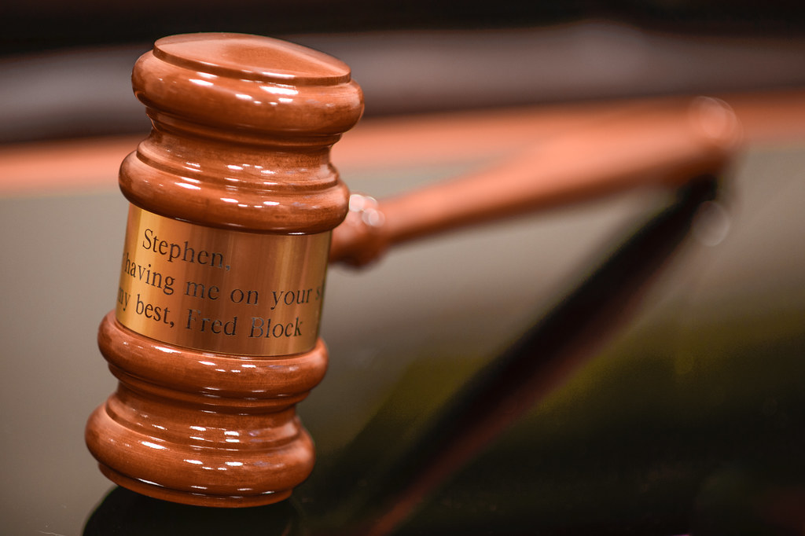
WISH LIST What would the Girl State Board like to have?
A question that is hard to answer but we put our thinking hats on and decided these items would be great to help the program.
1. An engraved Gavel for each city’s mayor to use, then to be able to take home as a keepsake for her time serving as a mayor at this years’ session. 4 needed
2. Purchase a seat on the field trip bus. Roughly $30.00 per seat.
3. Gift Cards for Walmart, Hy Vee, Walgreens, Sams- or Cash. Please send gift cards to Bev but all cash goes directly to the department office. The gift cards will be sent to department as soon as they are recorded.
4. Cash for staff meals on Saturday evening, Sunday breakfast and lunch. Drake does not start serving until Sunday evening.
5. Cash for incidentals.
Thank you for all the support- monetary, sponsoring, participating, and sharing the info.
This Photo by Unknown Author is licensed under CC BY

Slide 28

Days of the Week with Focal Point
Sunday
Suspenseful Sunday
Get to know each other
District Caucus
Monday
Magnificent Monday
Tuesday
Terrific Tuesday
State and County Caucuses
Wednesday
Winning Wednesday
Field Trip
Primary Election
Thursday
Triumphant Thursday
General Election
Friday
Farewell Friday
Community Service Project
Inauguration
City Elections

Slide 29

MID WINTER FUNDRAISER
The traditional silent auction during the Mid -Winter Conference will continue but we will have three different categories:
You can decide to donate a “Themed Gift” of your choice by filling a basket or box with items such as edible foods, gift certificates or any related product.
“White Elephant” including gently used or new merchandise or
Bake Sale
We are asking for participation from individuals, units, counties, and districts.
Hopefully, many will help by donating to the auction and participating in the bidding.

Slide 30

WHAT?
  WHERE?
    WHEN?
      WHO?
        WHY?

Slide 31


A of APPRECIATION
A huge and grateful THANK YOU is extended from the Iowa Girls State Board.
Without the generous support and donations from the entire Department of Iowa American Legion Auxiliary, the American Legion and the Sons of the American Legion members we would not or could not continue to Grow and keep on giving young woman the chance of a lifetime. The opportunity to attend the Iowa American Legion Auxiliary Girls State.
Two small words that mean so much: THANK YOU…

