Slide 2
Iowa American Legion Auxiliary Girls State
Welcome to the
Iowa American Legion Auxiliary Girls State
On-line Orientation
Welcome to the Iowa Girls State On-Line Orientation
Information for Citizens and Parents

Slide 3
Welcome!
Congratulations on your selection to Iowa Girls State, one of the premiere programs of the Iowa American Legion Auxiliary.
This presentation will prepare you to attend the Girls State session this summer, and attempt to answer any questions you might have at this time.

Slide 4
History of Iowa Girls State
Iowa Girls State was started by 5 women in 1946 who wanted to organize a project to train young women of high school age in the responsibility of citizenship. Many problems were encountered and overcome by this first group of women who worked so hard to create Hawkeye Girls State. Many things that were implemented in that first Girls State session remain the same today.

Slide 5
Founders of Iowa Girls State in 1946
Leona Ladehoff, Clinton, IA
Margaret Hinderman, Wapello, IA
Margaret Carr, Des Moines, IA
Beona Young, Bloomfield, IA
Kay Hanson, Decorah, IA

Slide 6
Highlights through the years of Iowa Girls State
In 1956, Girls Staters won money on a television program and used the money to purchase a Girls State banner to fly in front of their dorm.
In 1966, Hawkeye Girls State was officially changed to Iowa American Legion Auxiliary Girls State.
In 1970, Iowa Girls State celebrated its silver anniversary with many former Governors returning.
In 1974, the Girls State sign was stolen but returned in 1975.
In 1981, Past Dept President Florence Long presented a plaque to the retiring Governor to be displayed in her High School. A tradition that continues today.

Slide 7
In 1995, Iowa Girls State celebrated its 50th anniversary. A memory book was made listing each Girls State Governor along with their memories of their year as Governor. All speakers that year were former Girls Staters and the Girls State pins were engraved with “50th anniversary.”
In 2005, in honor of the 60th anniversary, Iowa Lt Gov Sally Pedersen delivered a proclamation from the Governors office.
In 2006, the American Flag that was flown during the week she served as Governor, was presented to the retiring Governor at Inauguration.

Slide 8
Locations and size of Iowa Girls State
Grandview College, Des Moines
100 girls
Grinnell College, Grinnell
Up to 285 girls
University of Northern Iowa, Cedar Falls
Up to 320 girls
Iowa State University, Ames
Up to 350 girls
Drake University Up to 350 girls

Slide 9
But what really is Iowa Girls State?
It is a study of
City Government
County Government
State Government

Slide 10
City Government
This is probably one of the first places where you will be involved at Iowa Girls State.
You will be allowed to campaign for Mayor and Councilman by speaking to the citizens in your City to convince them why you would be the best candidate for the job.
You will fill city appointment positions and pass ordinances.

Slide 11
You will be a citizen of one of these Cities
Glynn
Hanson
Harper-Rhea
Hinderman
Ladehoff
McLaughlin
Young

Slide 12
County Government
County Officials will campaign during the Primary Nomination process and are elected in the General Elections.
Once elected, they will be making county appointments and possibly be involved in a mock trial.

Slide 13
Counties of Iowa Girls State
Carr County
Glynn, Hanson, Harper-Rhea, Hinderman
Macrae County
Ladehoff, McLaughlin, Young

Slide 14
State Government
State Officials will campaign during the Primary Nomination process and elected in the General Election.
May be involved in debate in the House or the Senate.
Sworn in during Inauguration on Friday.

Slide 15
Mythical State of Iowa Girls State
You are all citizens of the mythical state of Hawkeye.

Slide 16
When do I need to arrive?
Registration is Sunday.
10 AM to Noon at the Olmsted Center, Drake University
Registration involves:
Checking in so we know you have arrived
Getting your room key and other items you will need for the week.
Unpacking and getting ready for your first meeting
Lunch is on your own.
Either eat before you arrive -or-
Come early and register and then go eat lunch.
Plan to arrive early - NO late registrations!

Slide 17
Again, arrive with plenty of time before your first meeting - sometimes what takes the longest is getting to your room - elevators and stairwells can only accommodate so many people at once!
The girls on your floors will meet together around 12:30 PM so you may all walk together to Olmsted for Opening Ceremonies.
Plan Lunch accordingly so you have plenty of time to eat and get ready by 12:30 PM.

Slide 18
There are so many ways to get involved!
All of the former Governors and citizens of Girls State say you get out of the experience what you put into it - take the opportunity to get involved on Sunday afternoon.
Don't just sit back and watch - become government in action!
Take a some time to think about what office you might want to run for on that first day.

Slide 19
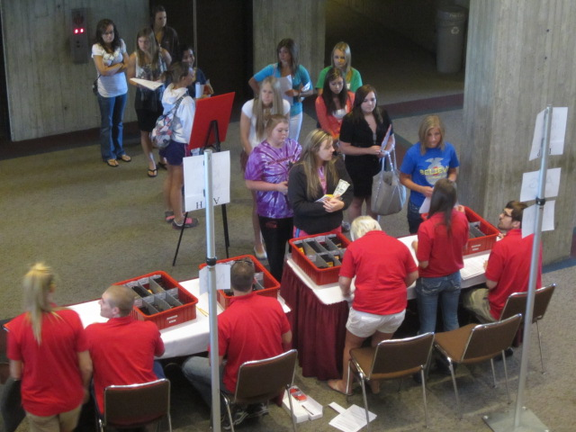
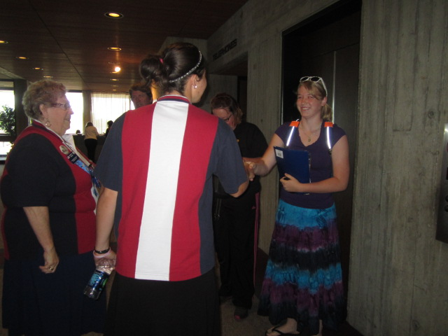

Slide 20
Sunday Activities
Opening Ceremonies
Take Pictures-remember to smile for the camera!
First Meeting-Party Precinct Caucus
Elect State Central Delegate
Elect District Secretary
Elect or Appoint Election Official
Evening activities may include:
Motivational Speaker
Scavenger Hunt

Slide 21
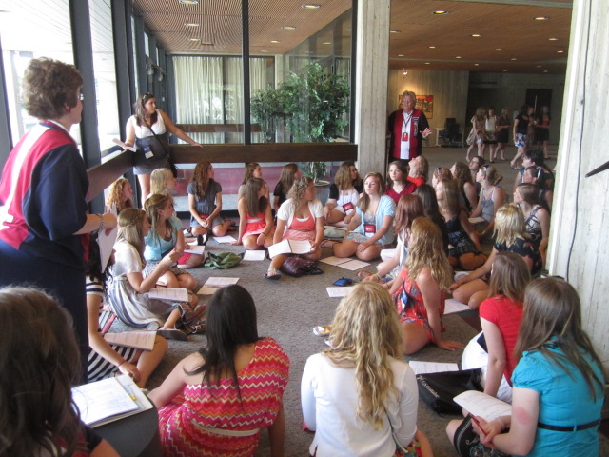

Slide 22
Monday
City Campaigning and Elections
Guest Speaker
Announcing new Mayors and City Councilman
Starting City business including appointments and working on ordinances
Flag Disposal

Slide 23
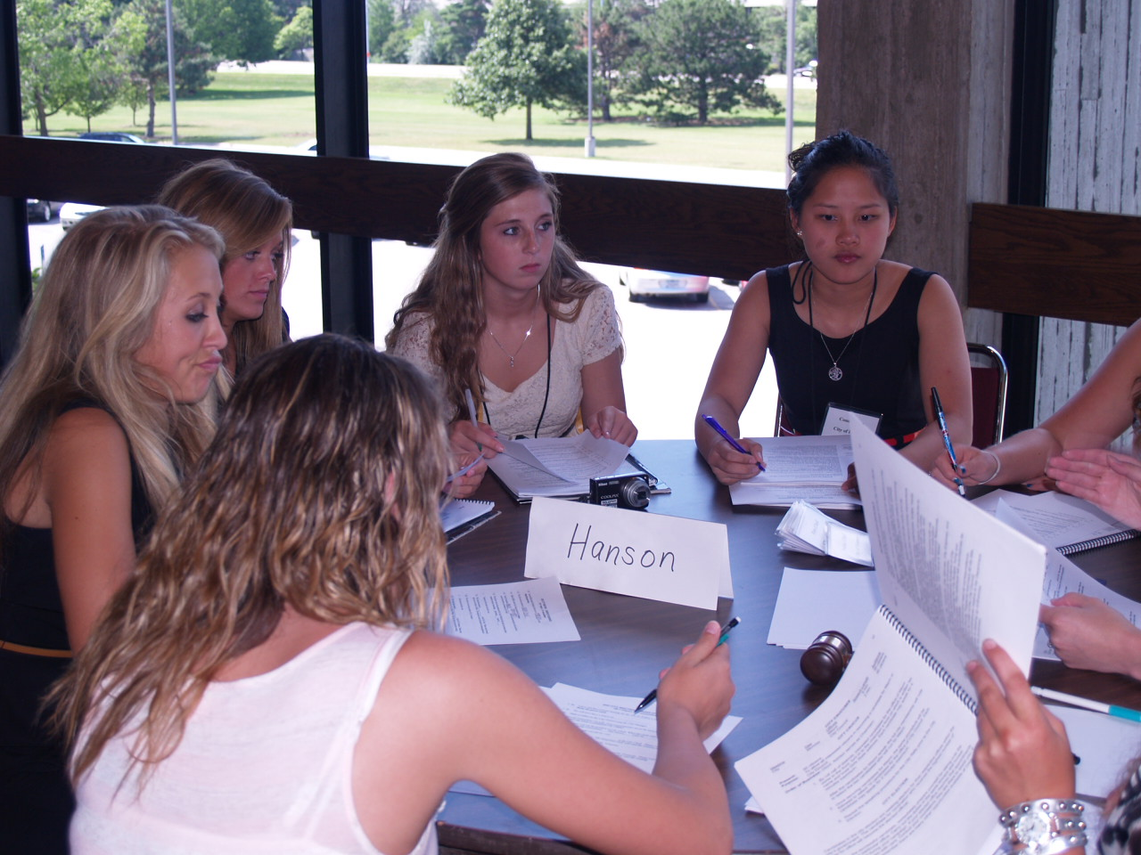
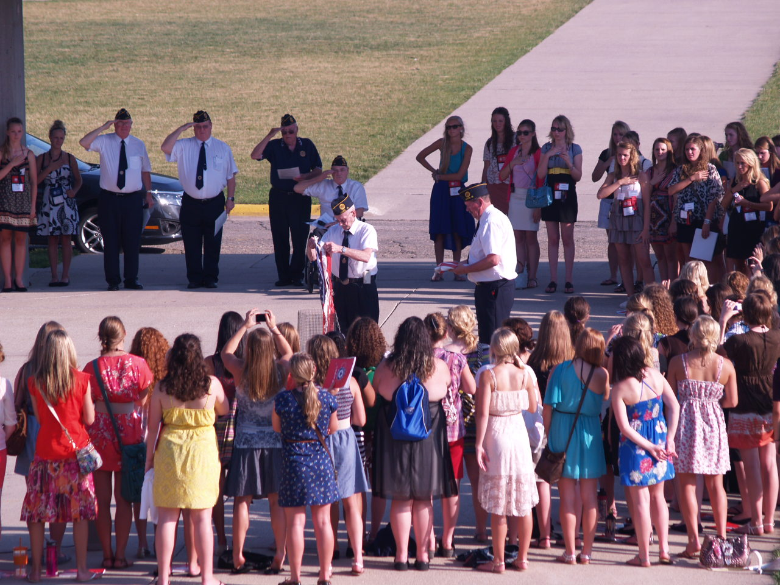
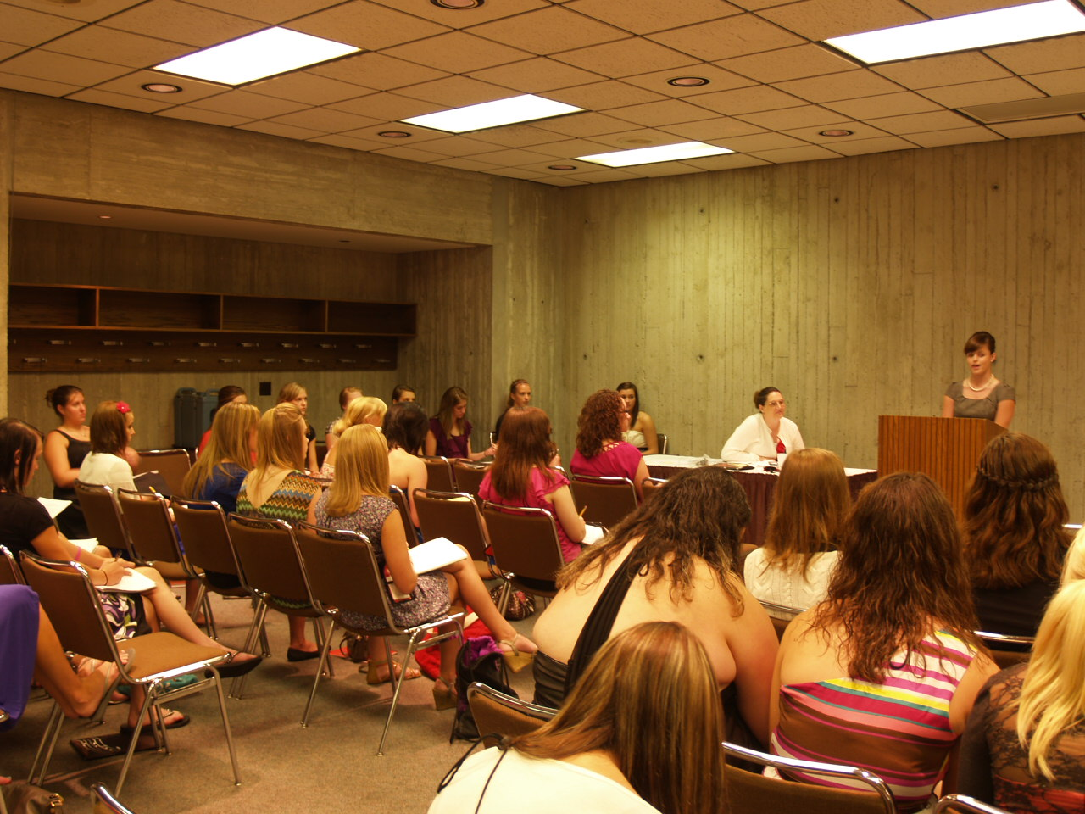
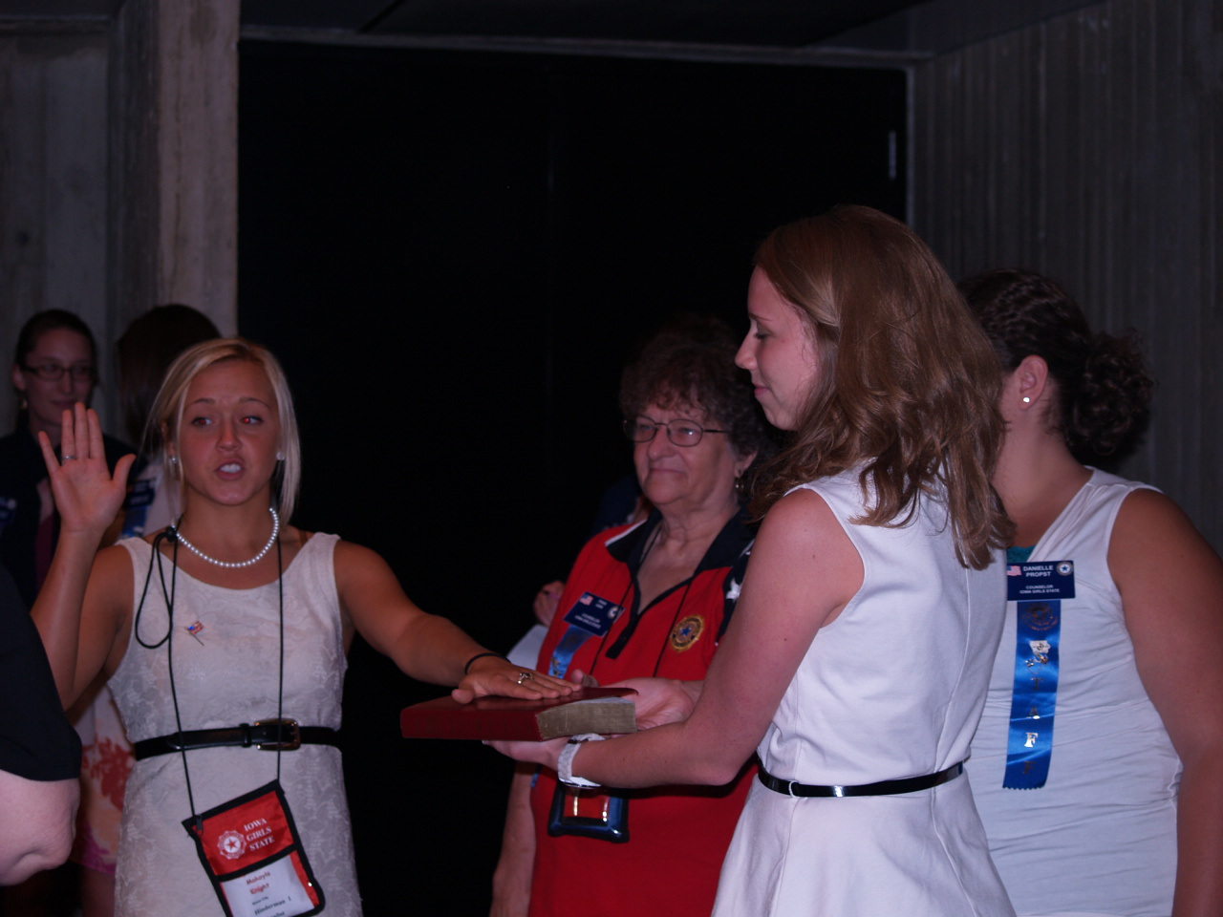

Slide 24
Tuesday
Girls Nation Speakers
Learning how the two party system works
Primary Campaign
Lots of people running for offices!
Party Rallies at night.
LOTS OF FUN!!!

Slide 25
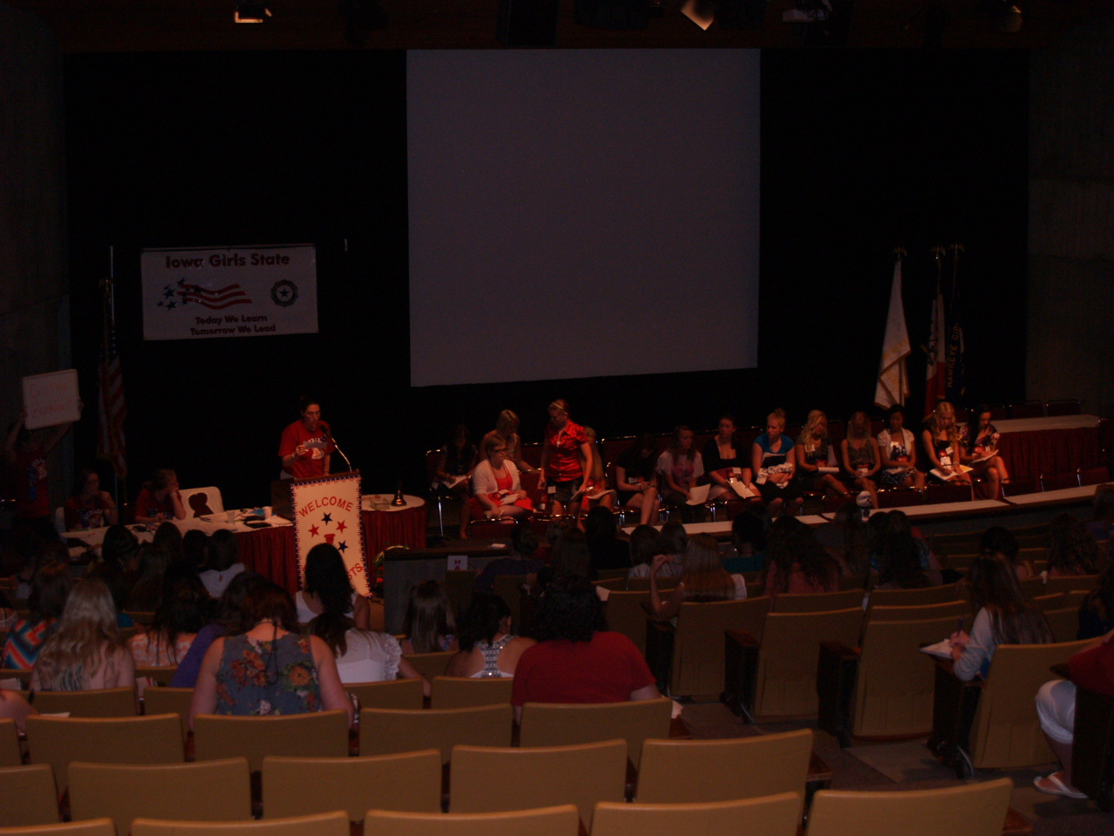
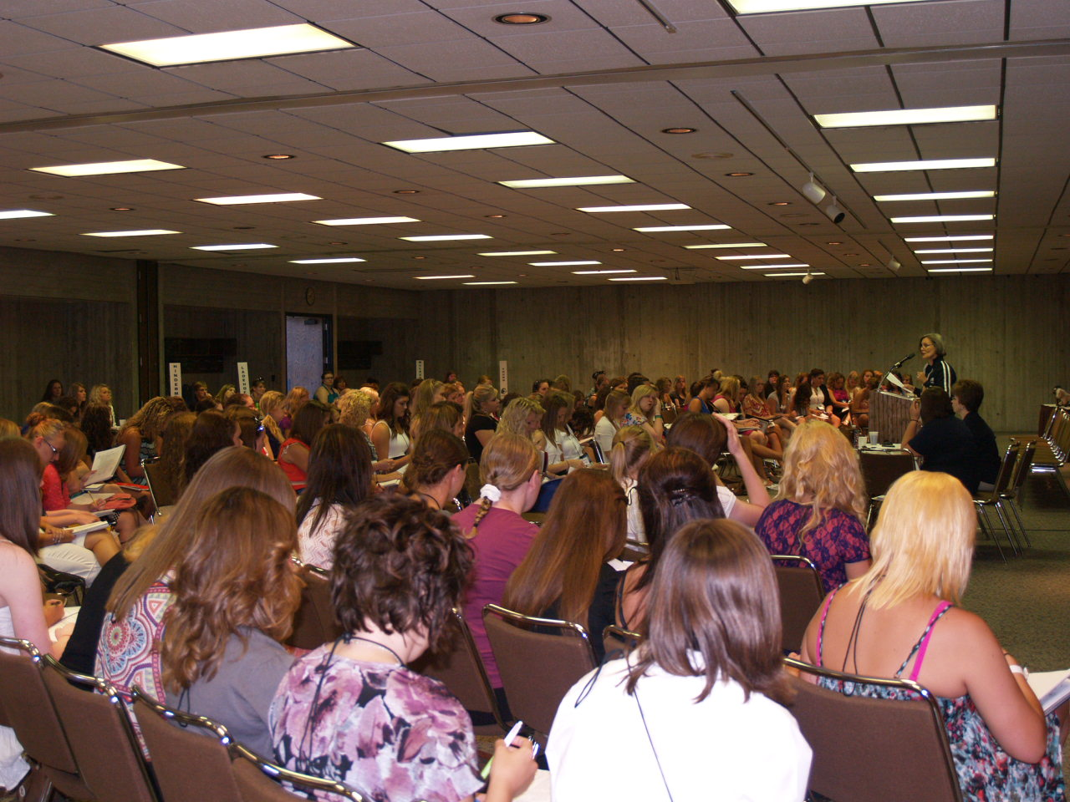

Slide 26
Wednesday
Primary Elections and Results
Guest Speaker
Party State Convention
Special Activity

Slide 27
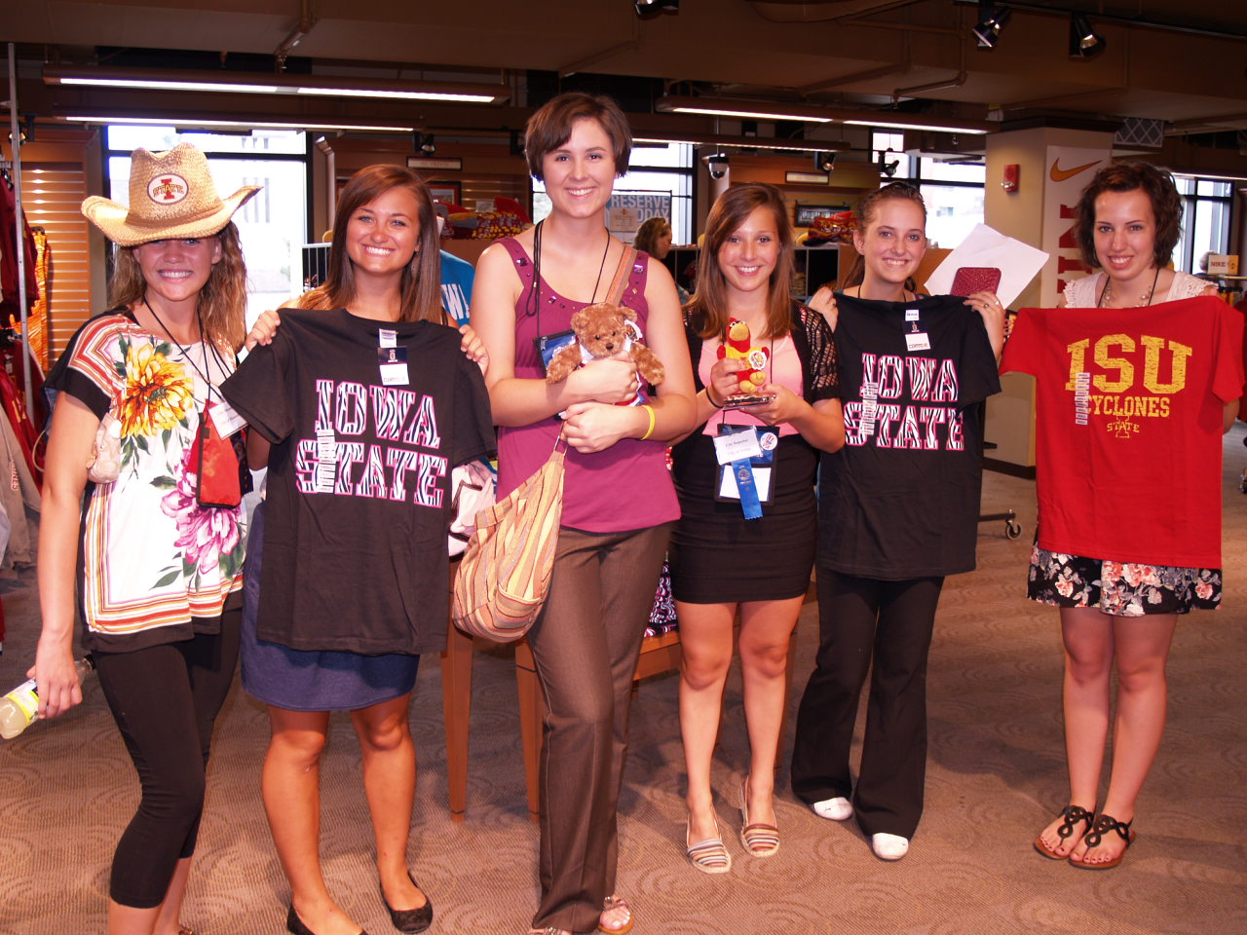
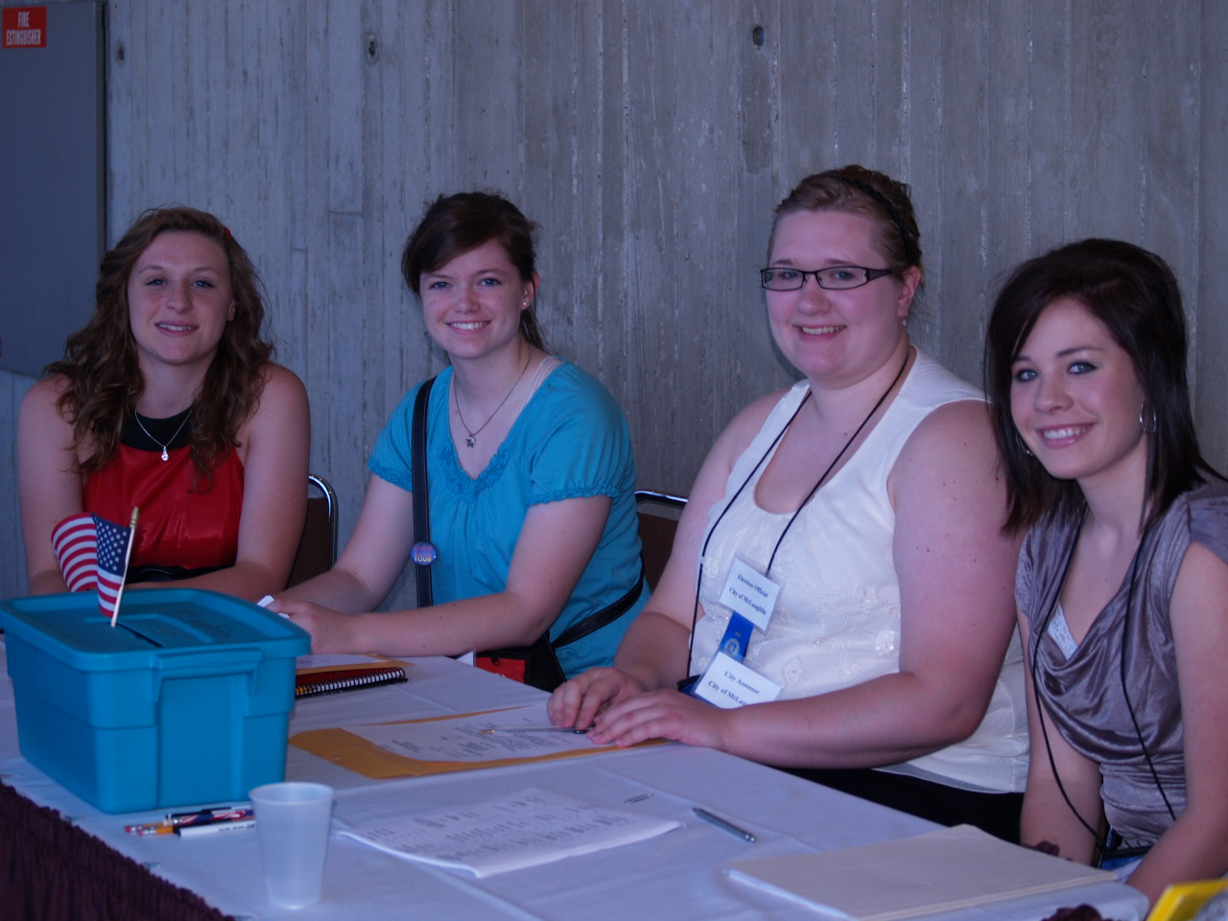

Slide 28
Thursday
County and State Rally’s
Whistlestop Campaigns for the Governor and Lt Governor Candidates
Elections
Election Results
Guest Speaker
Organizing of House and Senate
Fun Activities in the evening
Candle Light Ceremony

Slide 29
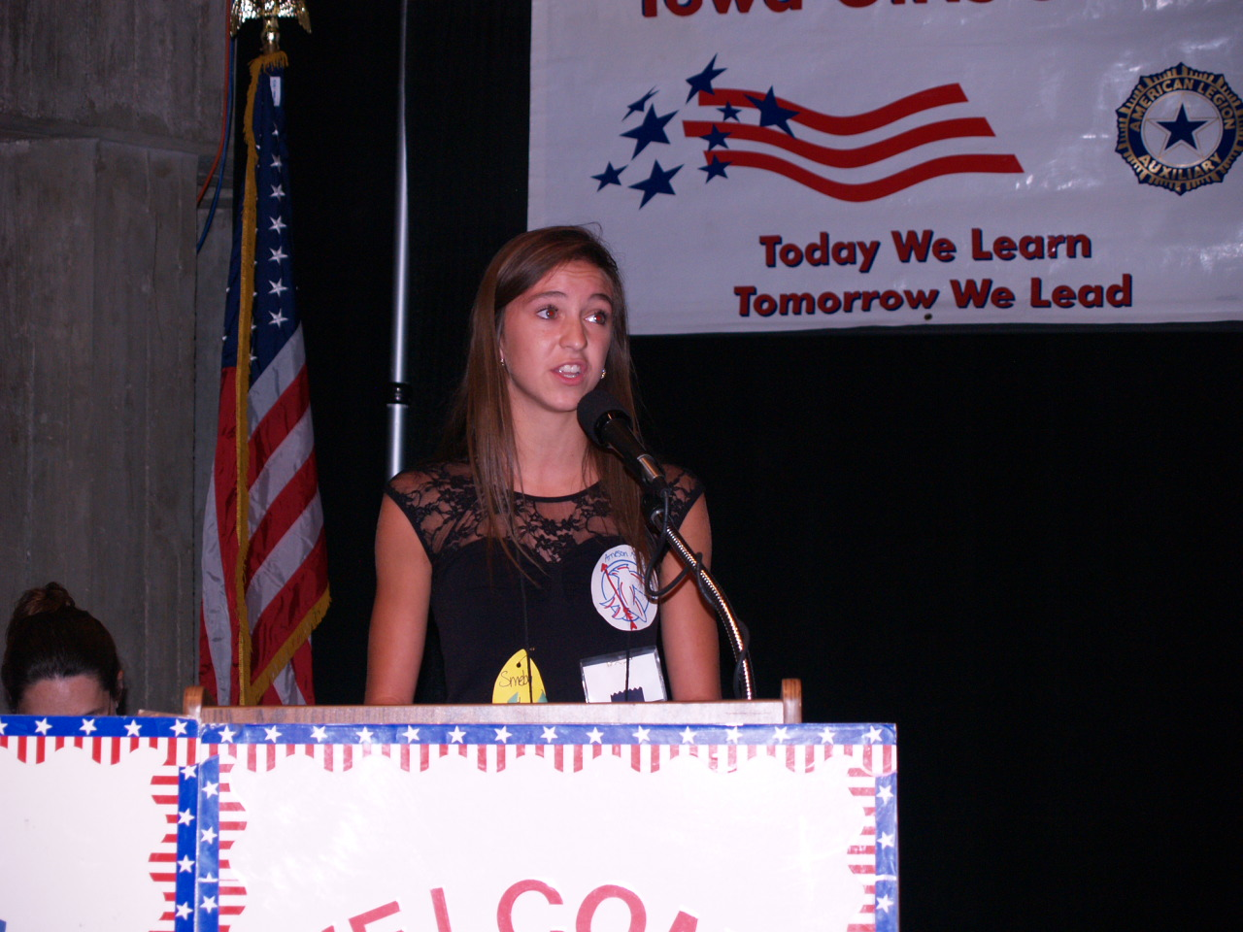
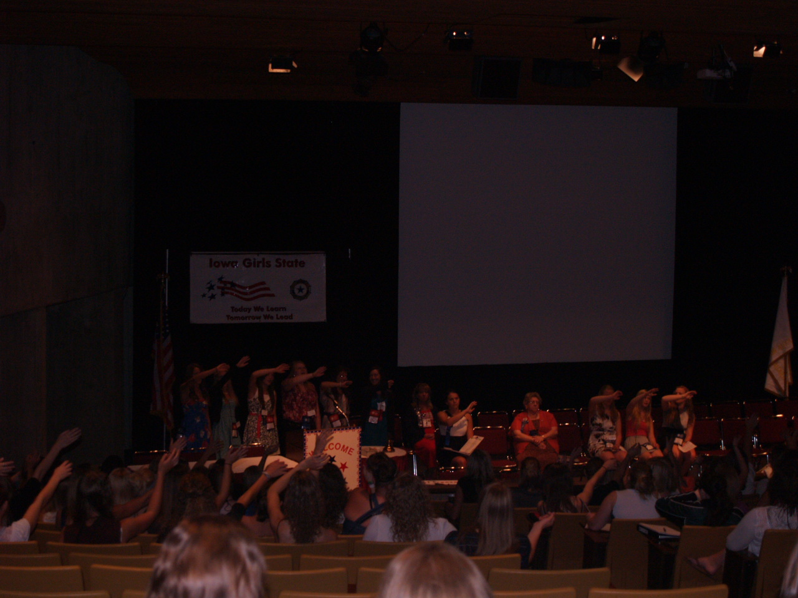

Slide 30
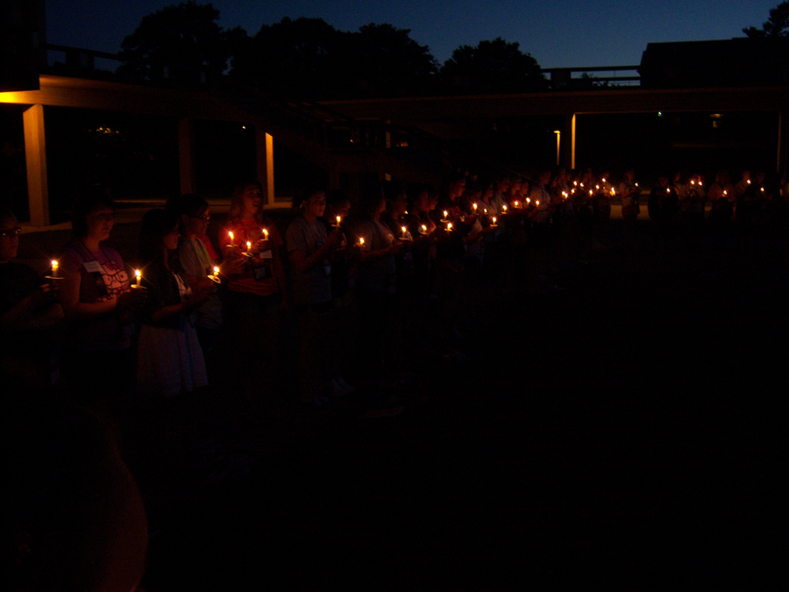

Slide 31
Friday
Governors Appointments
County Appointments
House and Senate Meetings
County Trials
Inauguration practice
Hors D’oeuvres Reception for Girls Staters
Flag Lowering
Inauguration
Good-Bye

Slide 32
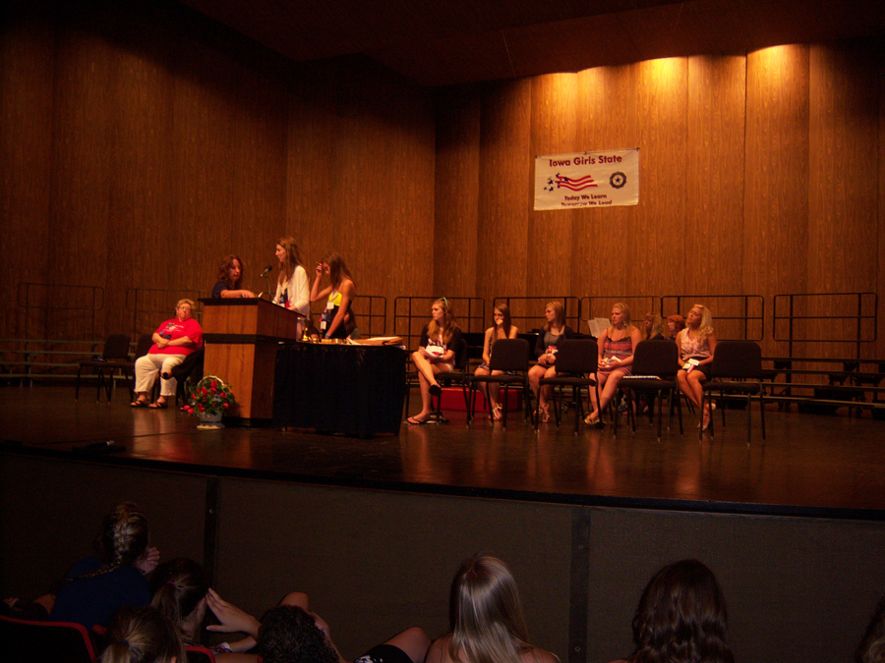

Slide 33
Inauguration Information
Inauguration is the culmination of the week.
Governor and her top officials are sworn in.
Parents and Guests are welcome.
Flag Ceremony – 5:00 PM (Flag Pole)
Inauguration Program – 5:15 PM
Scholarships awarded.
Girls Nation Senators announced.
Retiring Governor farewell address.

Slide 34
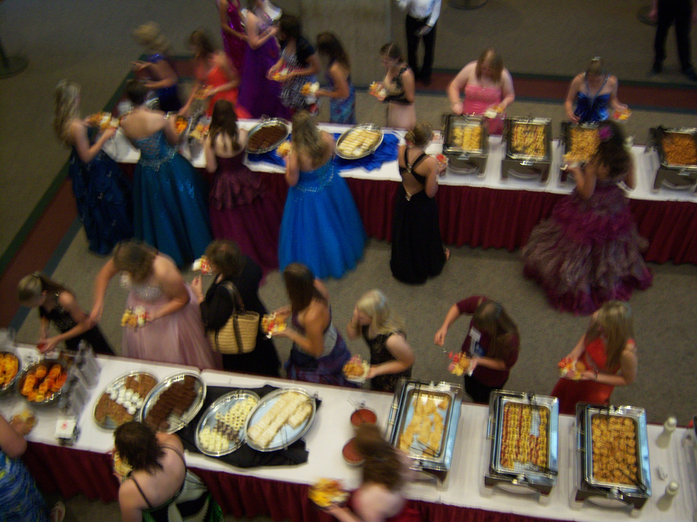
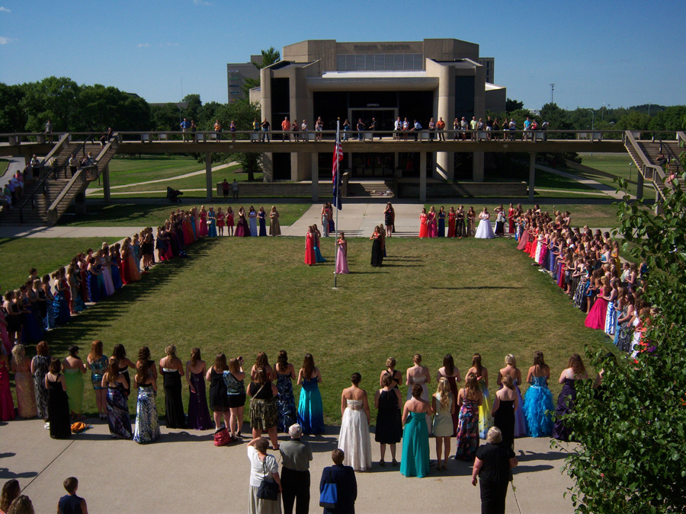

Slide 35
Everyday Activities
Flag Raising
Flag Lowering
Morning Medatation
Chorus
Reflection Time
This is a time where your floor will get together and discuss what happened during the day and go over what will happen the next day.

Slide 36
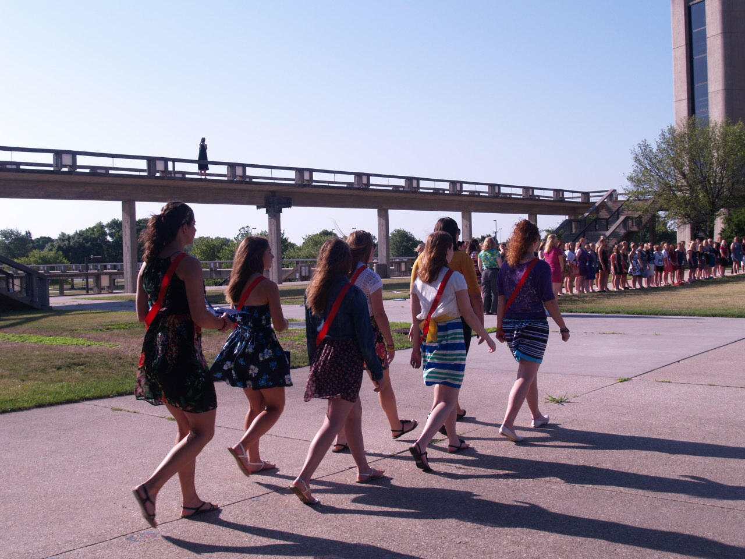
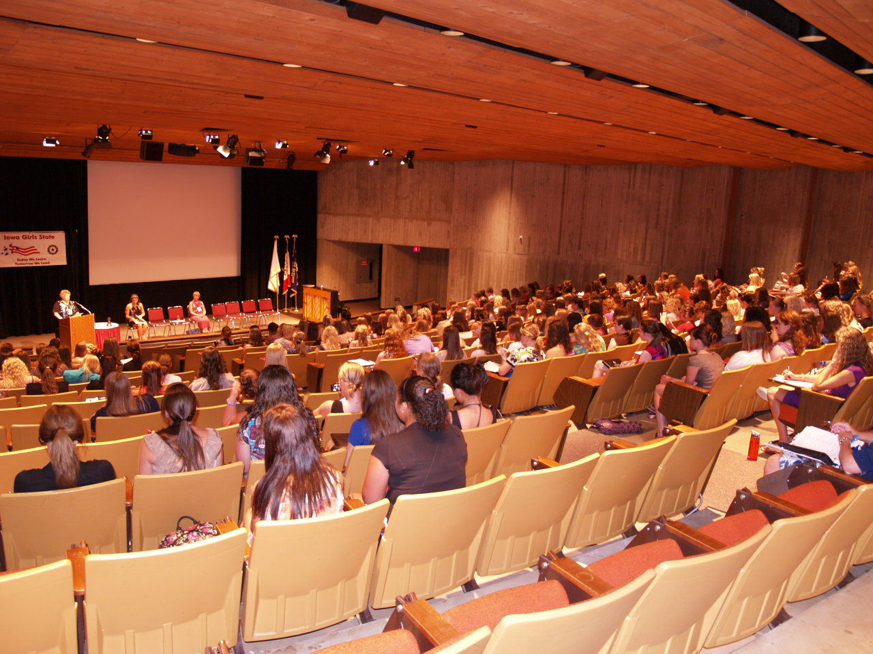
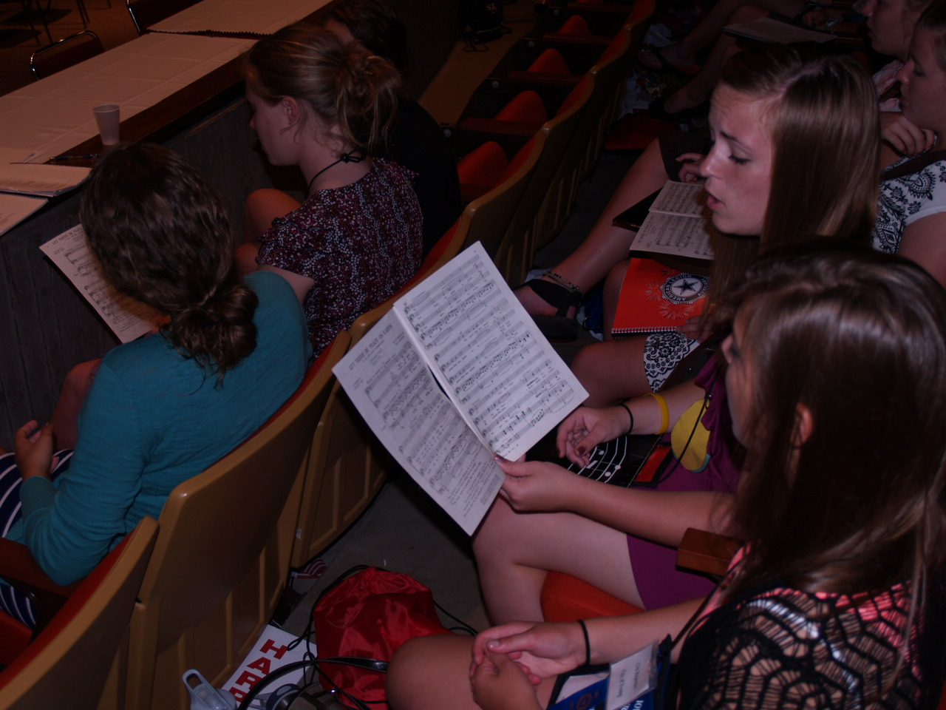

Slide 37
Girls State Schedule Overview
Guest Speakers include amazing women who many times are former Girls Staters and have achieved great things in their careers.
Chorus rehearsal: Everyone sings! You will be amazed at how wonderful the chorus sounds at the end of the week as part of the Inauguration ceremony.
There will be daily messages from the Girls State Governor and President of the Iowa Department of American Legion Auxiliary.
There will be Government Activities every day. They will be “learning by doing” activities so you should jump right in to fully participate in the program.

Slide 38
Flag Ceremony
Iowa Girls State is sponsored by the Iowa American Legion Auxiliary, a women’s patriotic organization whose beliefs are for God and Country.
Each day, Girls State citizens raise and lower the flag in a special ceremony.
Your city will have a chance to do either flag lowering or flag raising. Volunteer for the chance to do this.

Slide 39
Service Projects
Past donations have been made to:
Iowa Veterans Home
Wounded Warriors Picnic at Walter Reed
Paws & Effect Program-provides service dogs to veterans

Slide 40
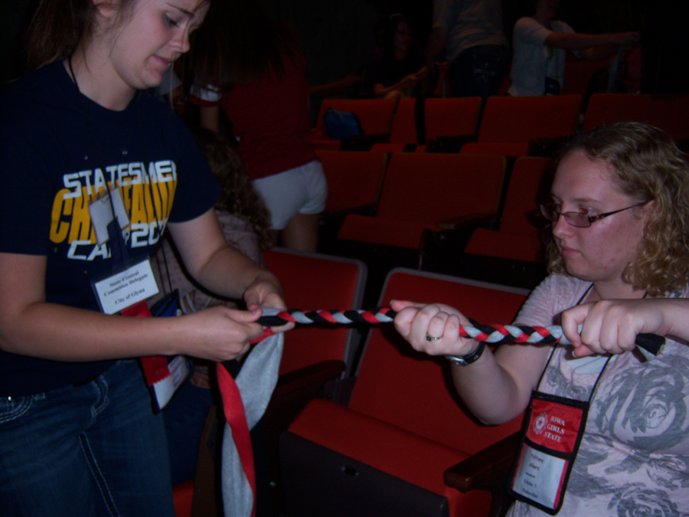
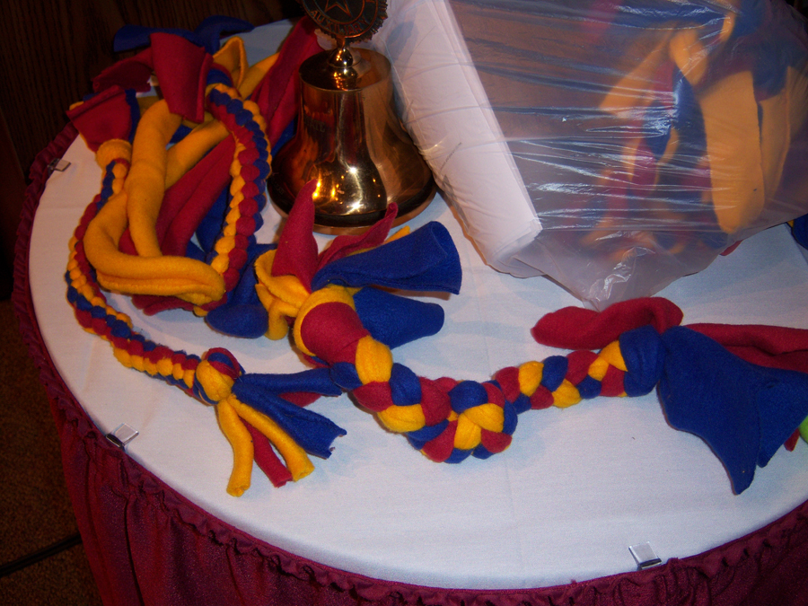

Slide 41
The Power of Your Vote
Your vote is powerful
Every vote counts, and at Girls State, every citizen votes in every election
Many races are decided by only one vote
Wouldn't it be amazing if all elections had 100% participation?

Slide 42
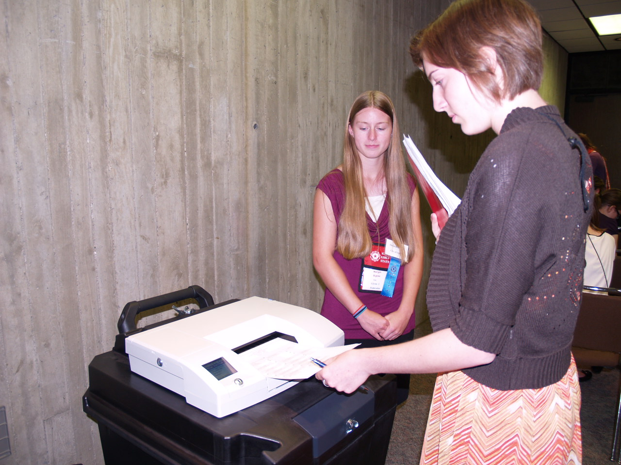

Slide 43
Suggested Packing for Girls State
Umbrella
Jacket
Sunglasses
Camera
Alarm clock
Water Bottle
Samsung Scholarship documents (if you qualify to apply - remember ALL documents!)
Cell phone (but NEVER use it during meetings)
Comfortable shoes

Slide 44
Towels/wash cloth/pillow/sheets and blanket
At least 4 dresses/skirts, plus 3 pairs dress pants (or more dresses/skirts)
You must wear a skirt/dress when guest speakers are present, and you'll want to look professional when running for office
Dress down for meetings /organized activities means no athletic shorts or jeans/jean shorts - bring khaki shorts, capris or something similar

Slide 45
Evenings after meetings and free time in the dorms you can wear casual clothes (athletic shorts, sweats, etc)
Prom dress for Inauguration
Money for snacks, or items at the Girls State store (the Girls State store is open Sunday during registration for parent shopping, too)
DO NOT bring pre-printed campaign material! Campaign supplies are provided.

Slide 46
Other Points of Interest
Lights out is at 11:PM - get your sleep, because each day is packed with activity!
All citizens attend all sessions, including flag ceremonies, meetings, and meals
There is little free time between meetings, so visitors are not allowed
Staff members are volunteers - either members of the American Legion Auxiliary or former Girls Staters

Slide 47
Samsung Scholarship Information
A scholarship for girls who have a direct lineage to a veteran.
Requires a high school transcript AND certification by a school official
Requires documentation of the eligibility through a veteran (document DD-214)
A scholarship opportunity which could award you a scholarship in the amount of $20,000
Find the Samsung Application on the Auxiliary website!

Slide 48
Iowa American Legion Auxiliary Girls State
is an educational opportunity which will make government and politics come alive
is run as close to Iowa law as possible
has a stellar reputation, and the expectation that you will act accordingly to maintain our image
is a once in a lifetime experience where you will learn a great deal about government, about yourself, and about some new people who will become close friends by the time you leave on Friday

Slide 49
Questions?
American Legion Auxiliary Department Office
515-282-7987
aladirector@ialegion.org
Iowaala.org and iowagirlsstate.org
Girls State Board Members:
Bev Copple, Director
Ann Rehbein
Kim Dixon
Department President
Department Secretary/Treasurer

