Slide 1
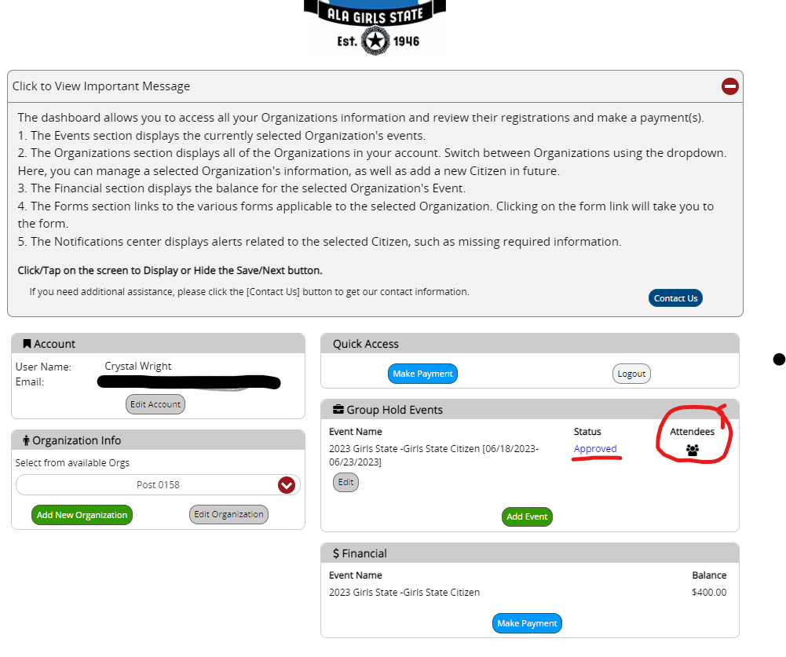
Unit/Post View of their Dashboard after Log in.
To view to see if your Citizen or Delegate has registered.
Please click on the Attendees people circled in RED.
Your status should say approved.

Slide 2
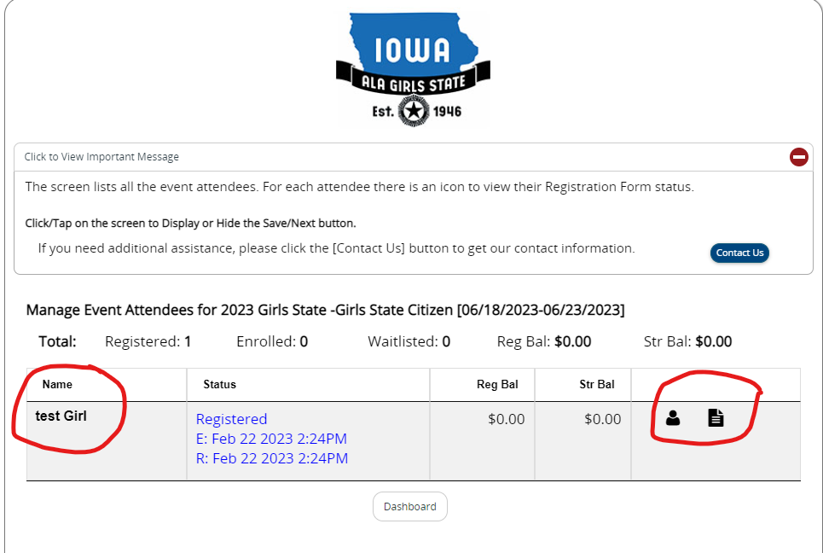
Citizen or Delegate information
Citizen's name will be on Left
There is a Person button –this is used to see if parents' info and citizens or delegate info is entered.
There is a Paper button- this is used to see if the citizen or delegate has filled out ALL forms.

Slide 3
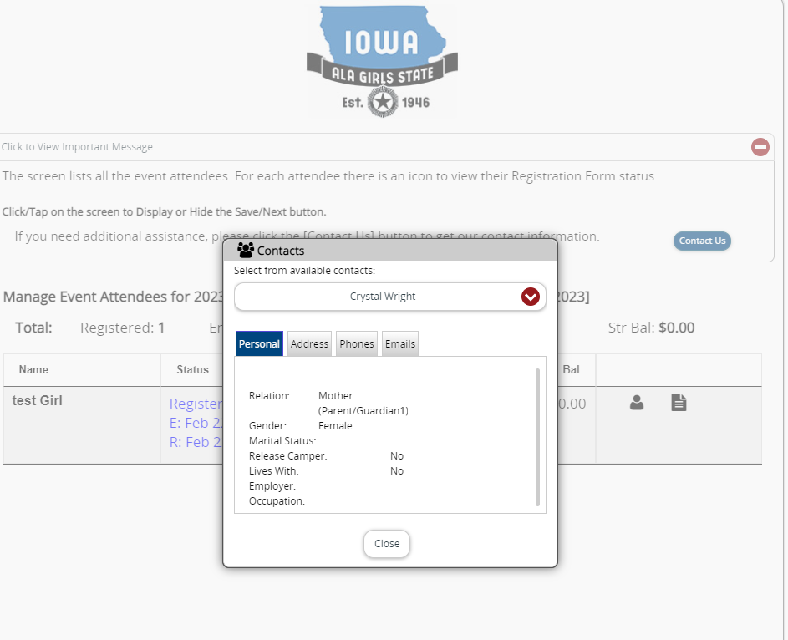
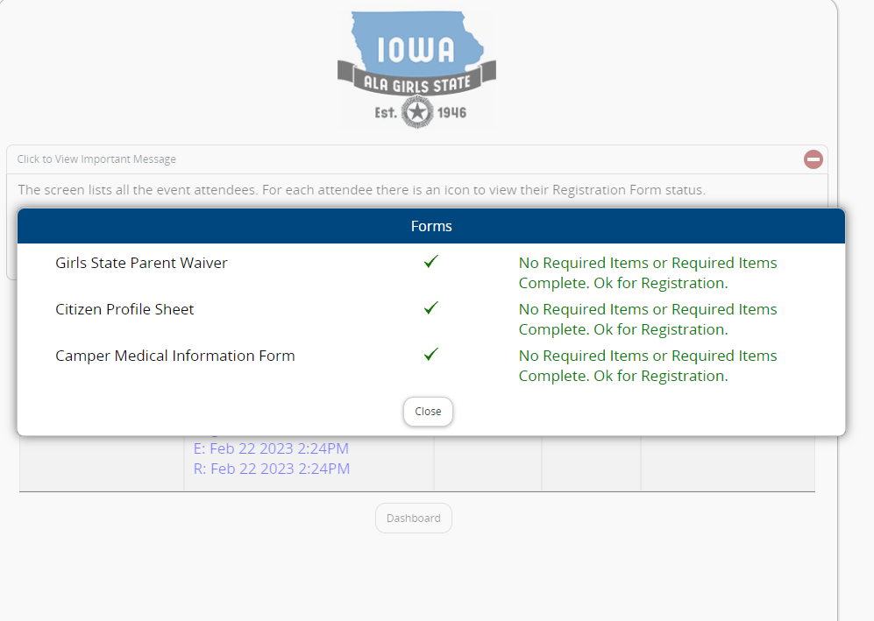
Left Photo is if you click on Person button Right photo is if you click on paper button View the citizen and parents' info X means incomplete Check mark means complete

